Slide 1
Tau Expression in Response to ProNGF Treatment in BFCNs

Slide 2
Background

Slide 3
Published Context
ProNGF — the precursor form of Nerve Growth Factor — was recently shown to drive retrograde axonal degeneration of basal forebrain cholinergic neurons (BFCNs) through the p75^{NTR} receptor and induction of amyloid precursor protein (APP).

Slide 4
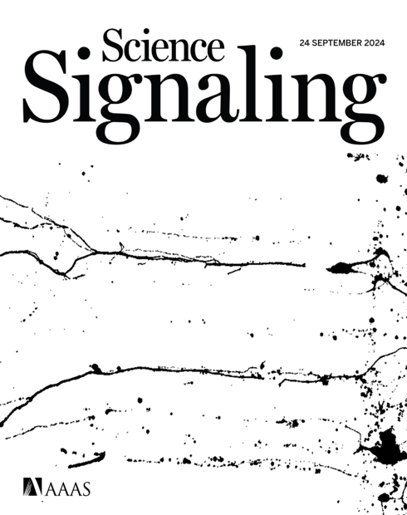
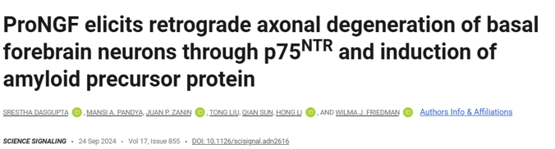

Slide 5
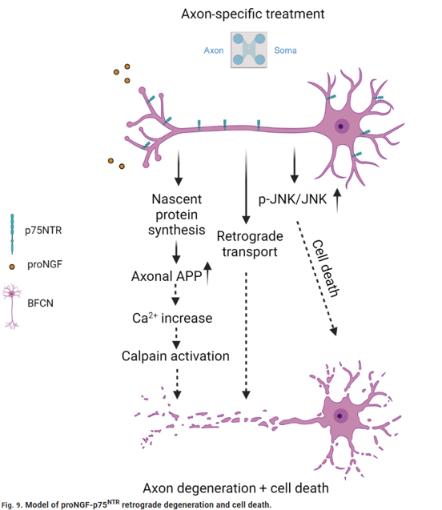
The Mechanism
ProNGF acts selectively on axons, triggering a cascade that leads to both axon degeneration and cell death:
Axon-specific proNGF → p75^{NTR} activation
↑ Nascent protein synthesis in axons, including APP
APP↑ → Ca²⁺ increase → Calpain activation
Concurrent retrograde p-JNK/JNK signalling → cell death

Slide 6
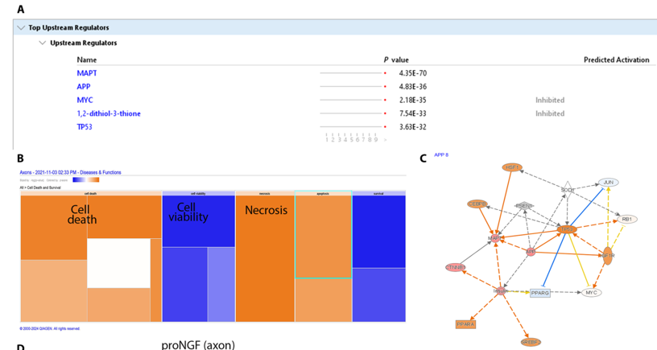
Prior Lab Data — Ingenuity Pathway Analysis (IPA)
To identify which upstream regulators are activated by axonal proNGF treatment, BFCNs were cultured in filter chambers that physically separate axons from cell bodies.
Axons were treated with proNGF for 30 minutes
Newly synthesised proteins were labelled with O-propargyl-puromycin (OPP)
After a 2-hour labelling window, axonal lysates were collected and analysed
IPA of the axonal proteome revealed MAPT (tau) and APP as the top upstream regulators (p = 4.35×10⁻⁷⁰ and 4.83×10⁻³⁶, respectively), with predicted downstream effects on cell death and necrosis.

Slide 7
Tau Isoforms & Protein Structure
Six CNS isoforms arise from alternative splicing of exons 2, 3, and 10 of the MAPT gene, generating 3R and 4R repeat variants that differ in microtubule-binding affinity. The protein contains an N-terminal projection domain, a proline-rich region, the microtubule-binding repeat domain (MTBD), and a short C-terminal tail. Phosphorylation sites in this study (pThr181, AT8, pSer622) all lie outside the MTBD.

Slide 8
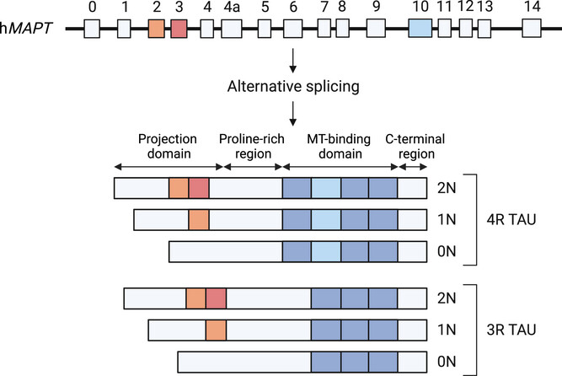
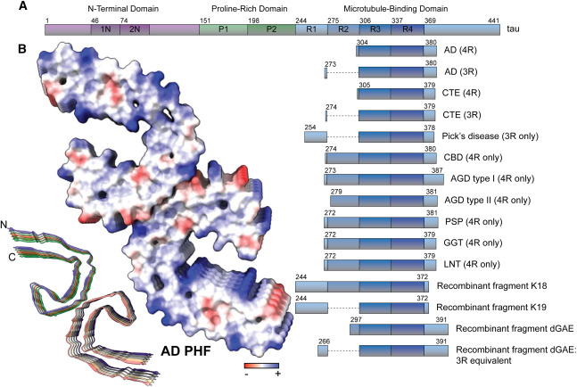
Tau isoforms (Alz journal).
Tau protein structure (ScienceDirect).

Slide 9
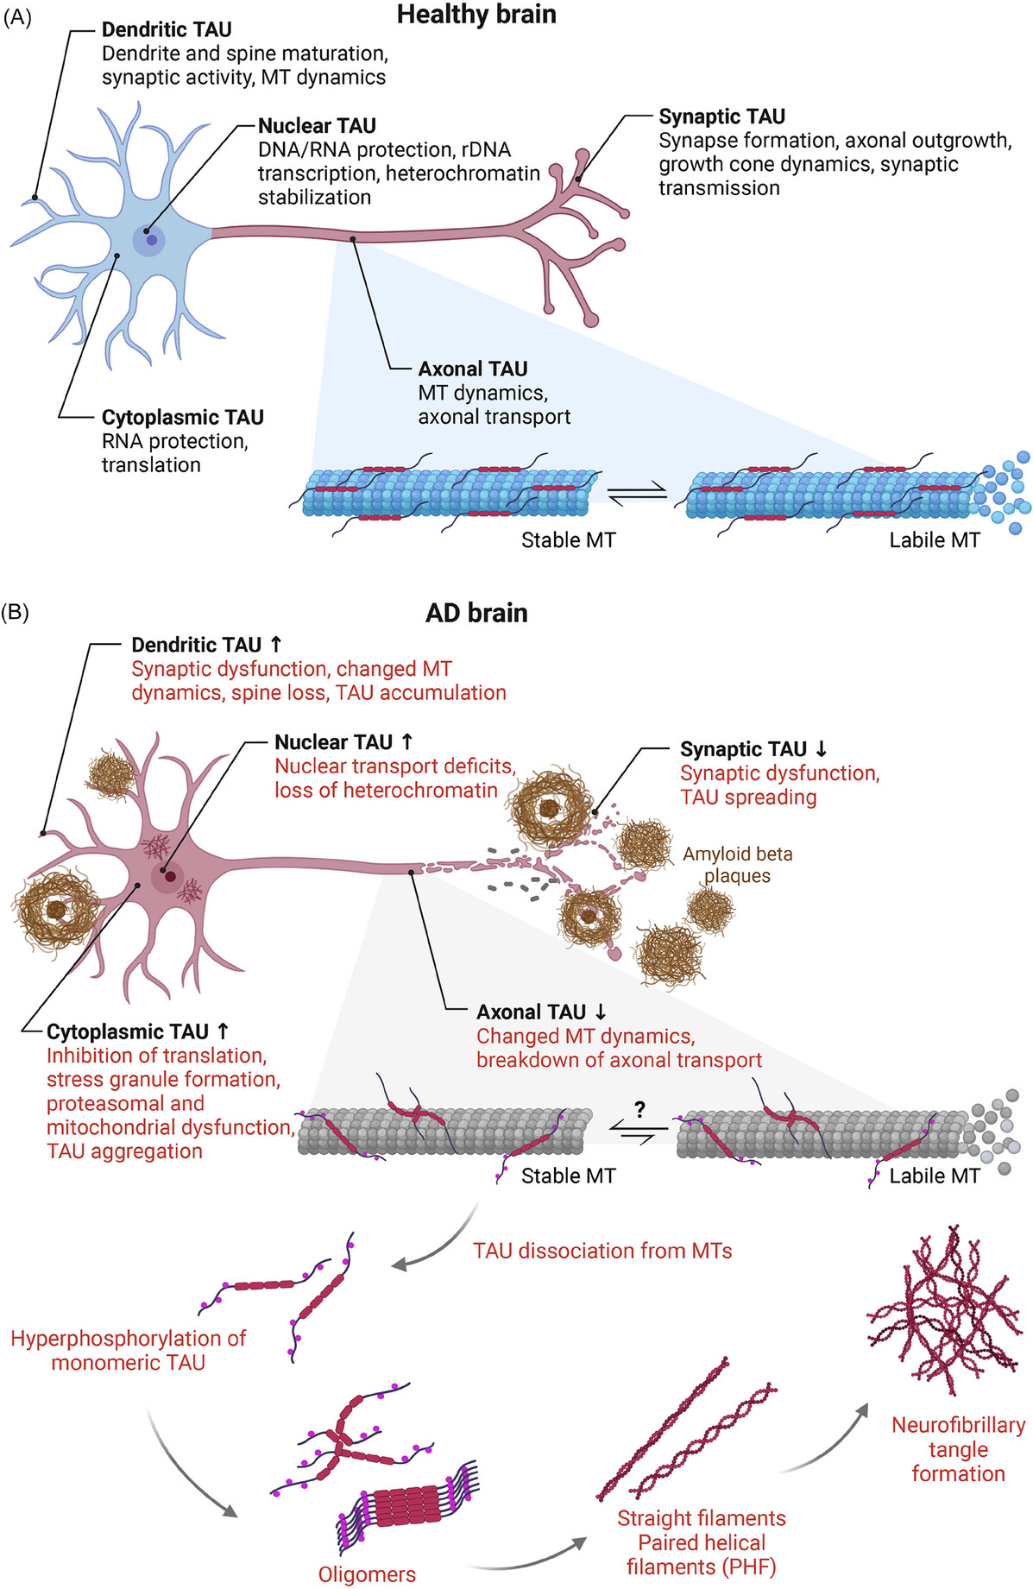
Tau: Beyond its Canonical Role
Microtubule stabilization and cytoskeletal coordination: Binds axonal microtubules to maintain cytoskeletal integrity and neuronal polarity. Integrates microtubule and actin networks to support axonal structure and dynamics.
Regulation of axonal transport: Controls kinesin- and dynein-based trafficking of vesicles, organelles, and signaling complexes.
Signaling scaffold: Organizes kinase and stress-response pathways linking extracellular signals to intracellular responses.
Synaptic function and plasticity: Participates in synaptic signaling, receptor regulation, and activity-dependent local translation of Tau.
Proteostasis and clearance: Interacts with chaperones, proteasome, and autophagy machinery to regulate Tau turnover.
Nuclear and stress-related roles: Can localize to the nucleus, where it may contribute to DNA protection and stress responses.
Sinsky, J., Pichlerova, K., & Hanes, J. (2021).

Slide 10
Rationale for This Study
The IPA data pointed to tau (MAPT) as a central upstream regulator of the axonal response to proNGF — yet the specific changes in tau protein expression and phosphorylation state had not been characterised.
This study asks:
Does proNGF treatment alter total tau and phospho-tau levels in the axon and soma compartments of BFCNs?
We used Western blotting with antibodies targeting three phosphorylation sites — pThr181, pSer202/pThr205 (AT8), and pSer622 — alongside pan-tau, to capture both the abundance and phosphorylation state of tau across compartments.

Slide 11
Total Tau Increase in Response to ProNGF Treatment

Slide 12
Overview
ProNGF treatment was applied to compartmentalized basal forebrain cholinergic neuron cultures.
Western blotting was used to assess changes in total Tau and phospho-Tau protein levels across soma and axon compartments.

Slide 13
Tau Phosphorylation Sites for Antibodies Used
In this research, I quantified tau phosphorylation using three antibodies that report distinct tau states:
pThr181 (p-tau181): commonly used biomarker-associated phosphorylation site that tracks Alzheimer’s disease-related tau pathology in CSF and plasma and is widely used for staging/stratification. Key kinases: GSK-3β, CDK5.
AT8 (pSer202/pThr205): canonical neuropathology epitope used to detect early and established pathological tau (pre-tangles/tangles) in tissue; often treated as a marker of disease-associated tau phosphorylation. Key kinases: GSK-3β, MAPK, CDK5.
pSer622: a C-terminal tau site assessed in biochemical studies; interpretation depends on antibody specificity and isoform context, and is typically considered alongside broader phosphorylation patterns. Key kinases: Casein kinase 1 and 2, GSK-3β.

Slide 14
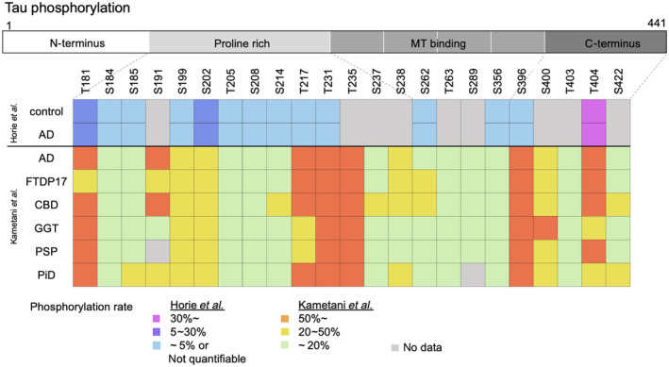
Phosphorylation Patterns of Tau
The figure shows the phosphorylation sites of tau identified in each disease and the frequency (Horie et al. and Kametani et al.).

Slide 15
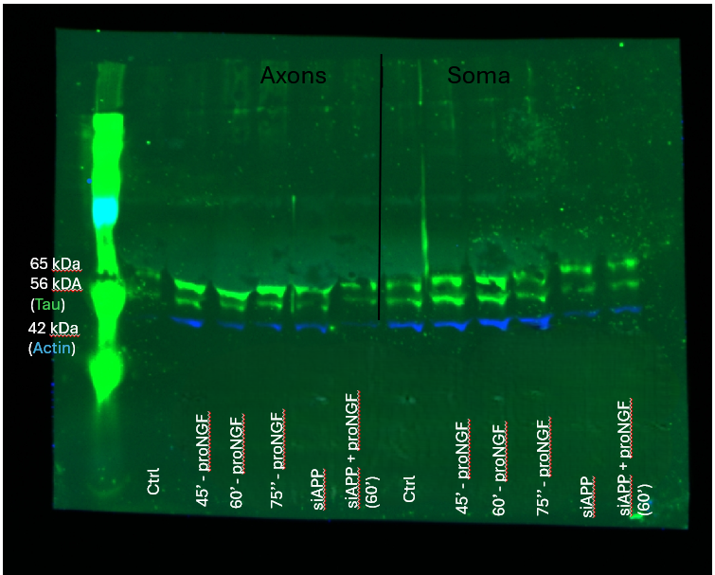
Composite Western Blot — All Compartments
Western blot analysis of Tau and actin expression. Composite image.

Slide 16
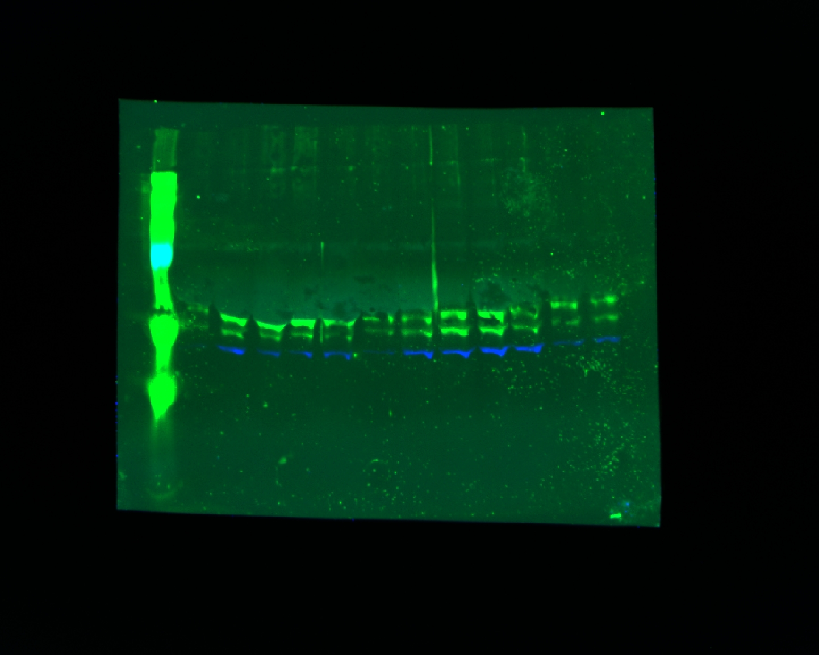
Representative Composite Image
Representative composite image showing actin (blue) and Tau (green).

Slide 17
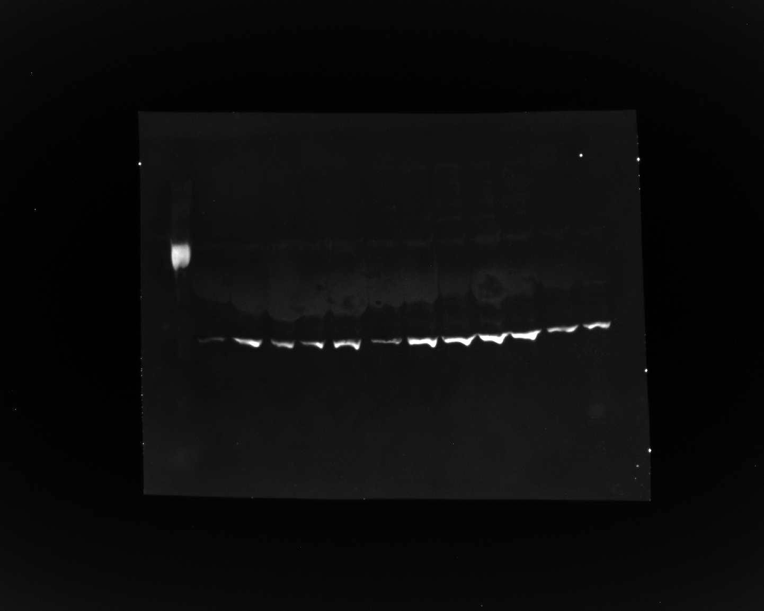
Green Channel — Actin & Phospho-Tau (800CW)
Green channel image showing actin (mouse) and phospho-Tau (rabbit; pSer202/pThr205).

Slide 18
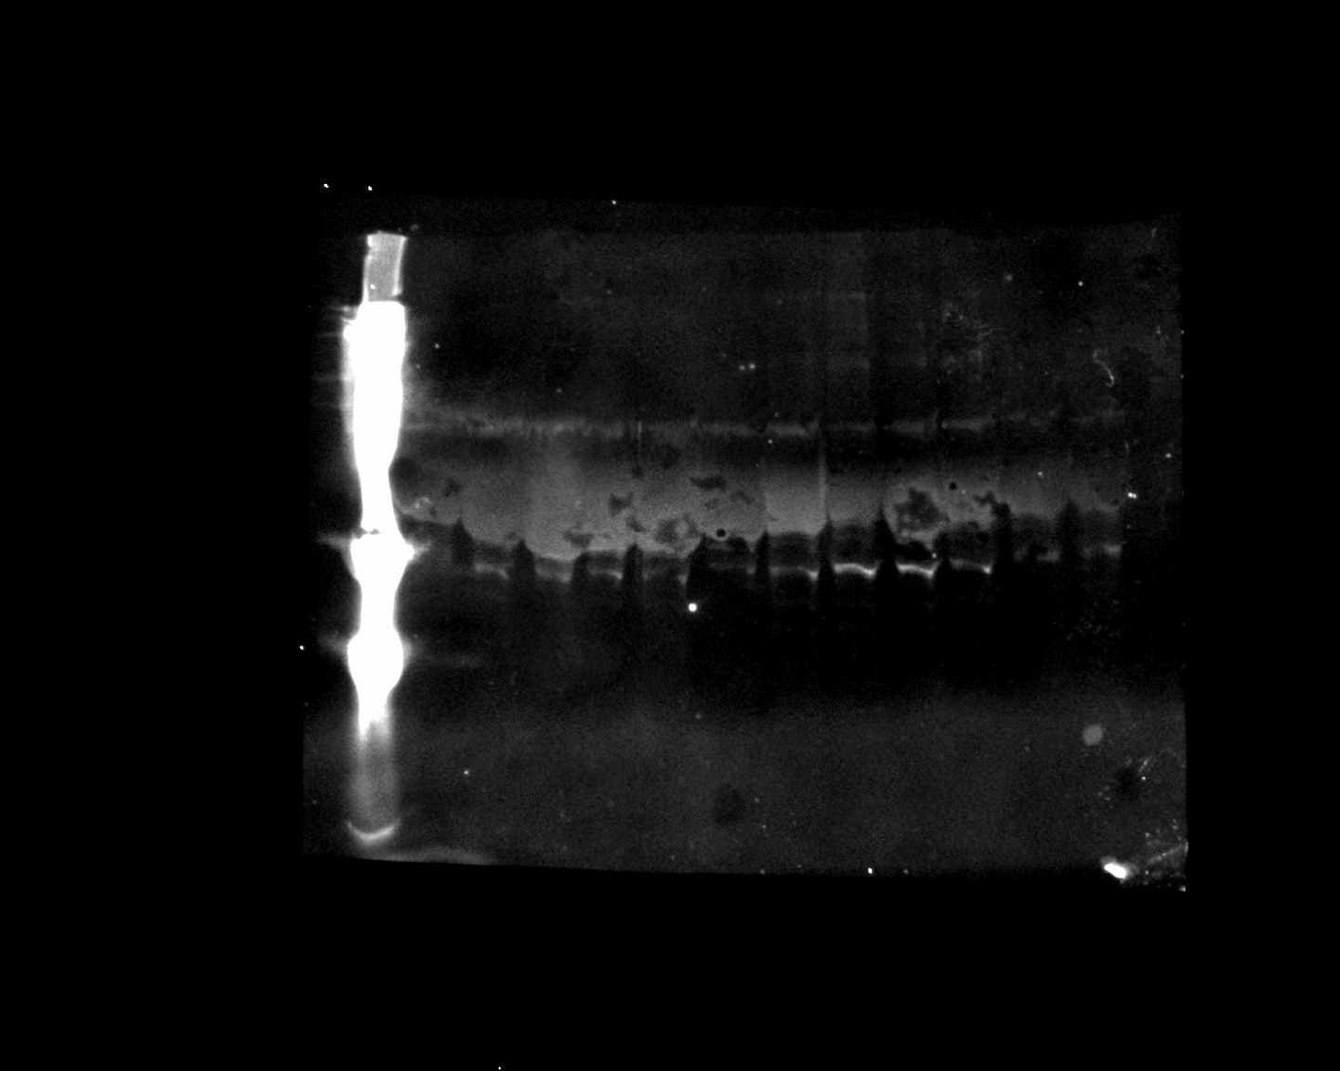
Red Channel — Total Tau (pan-Tau; Rb-237)
Red channel image showing total Tau (pan-Tau; Rb-237).

Slide 19
Soma-Only Repeat Western Blot

Slide 20
Overview
A repeat Western blot was performed on soma-only fractions from the same samples as above.
Targets: phospho-Tau (pSer622), pan-Tau, and actin.

Slide 21
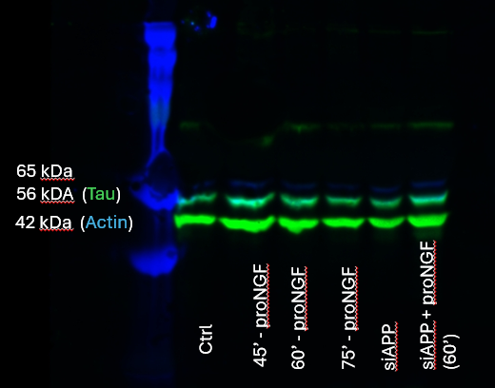
Soma-Only Composite Western Blot
Western blot analysis of phosphoTau, panTau and actin expression. Composite image.

Slide 22
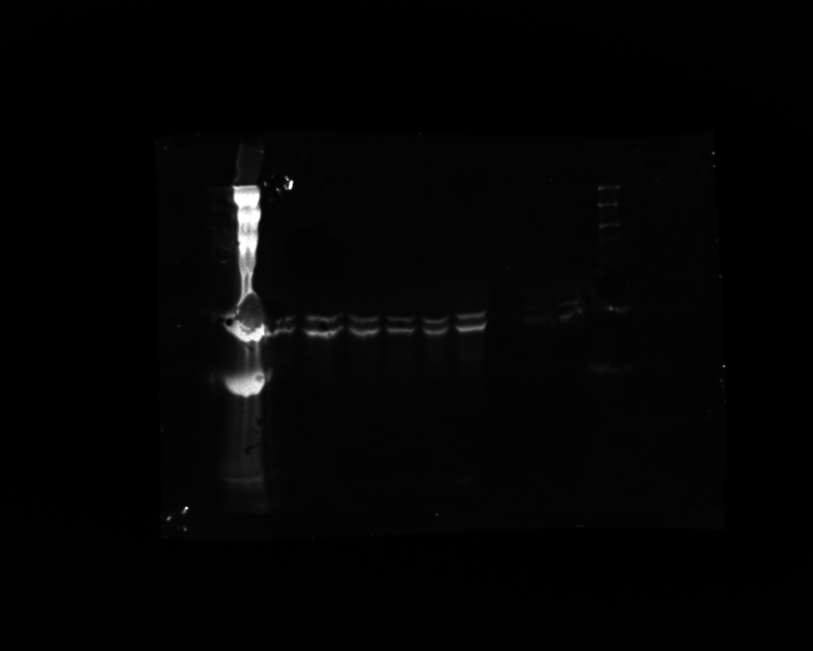
Red Channel — Phospho-Tau at Ser622 (680RD)
Red channel image showing phospho-Tau at Ser622 (pSer622).

Slide 23
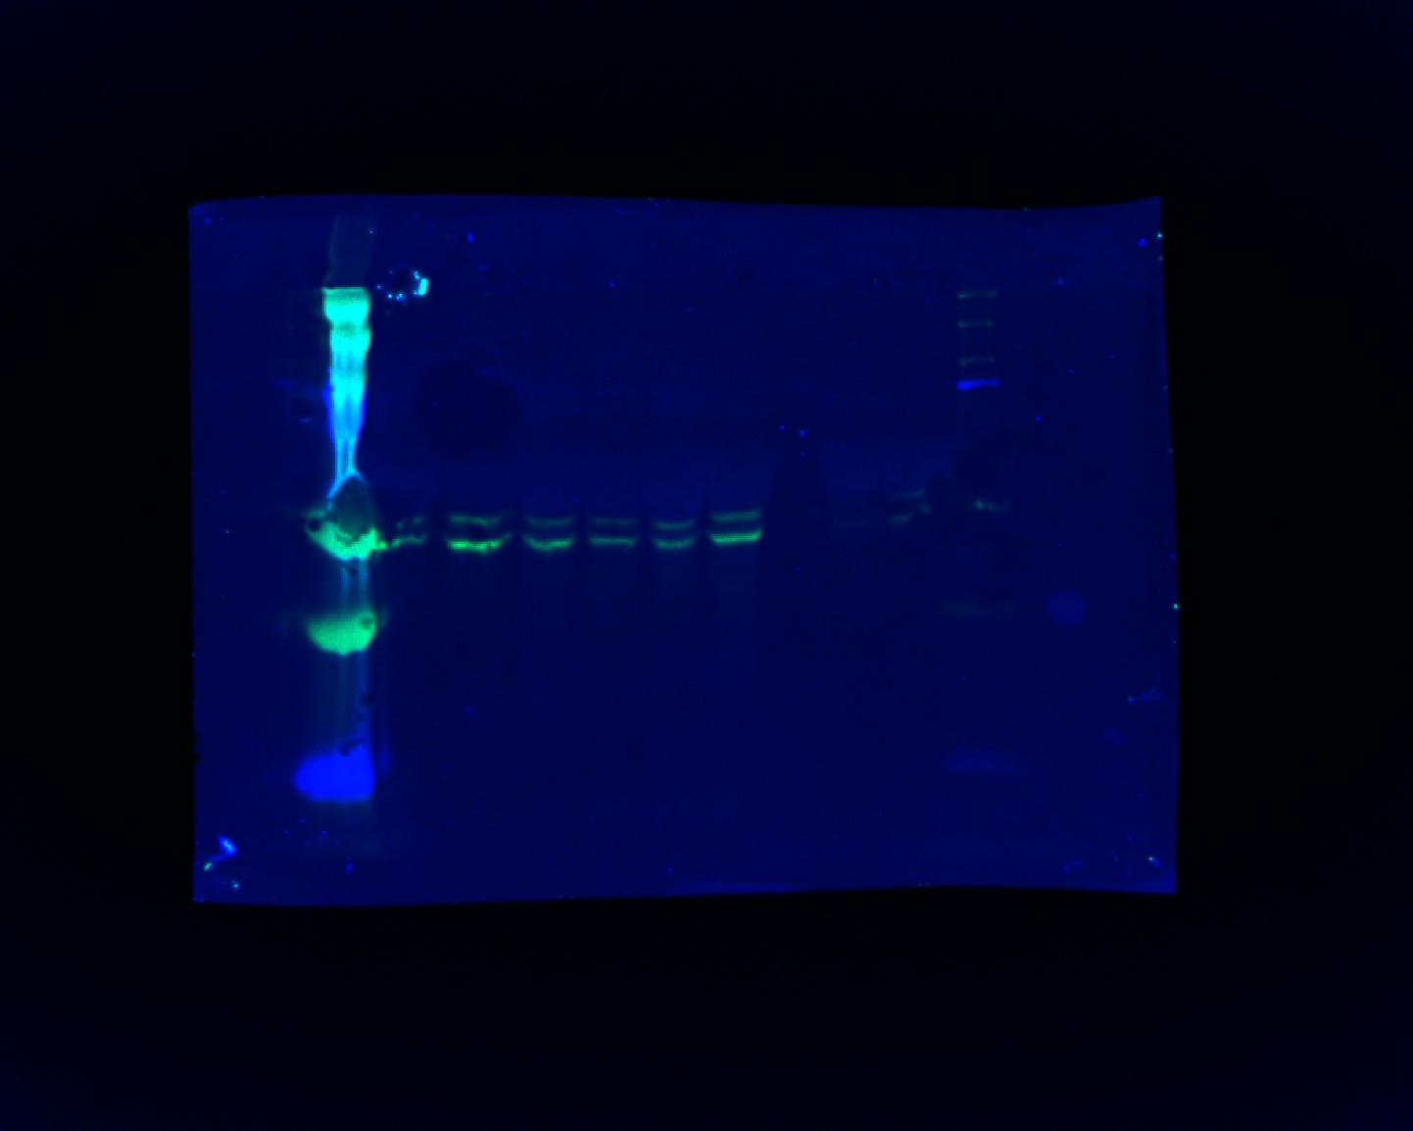
Composite — pSer622 & Pan-Tau
Composite image: phospho-Tau at Ser622 (red channel) and pan-Tau (green channel; Red antibody = Rabbit, Green antibody = Mouse).

Slide 24
Summary

Slide 25
Key Findings
IPA of axonal lysates after proNGF treatment identified MAPT (tau) and APP as the top upstream regulators, motivating a direct biochemical assessment of tau
ProNGF treatment induces changes in total Tau levels detectable by Western blot
Phosphorylation at pSer202/pThr205 and pSer622 sites assessed across compartments
Soma-only repeat blots confirm signal specificity in the cell body fraction
Next steps: Quantification of band intensities and normalization to actin loading control

